Slide 1




From Where You Get Your Energy
Done by: Fatema Hasan
Mahra Rashed
Maryam Mohammed
Instructor: Abeer Al - Rasby

Slide 2

Activity 1
First Step to be Together

Slide 3
Purpose
Team Work
Planning in short period
Trusting each other

Slide 4
Activity 2
Expressing yourself
Introversion: are generally shy. When they are stressed out, they get re-energized by spending time alone doing solitary activities.
Extraversion: are usually outgoing. When they need stress relief, they connect with others.

Slide 5
Introvert Characteristics
Energized by time alone
Private
Keeps to self
Quiet
Internally aware
Fewer friends
Prefer smaller groups
Independent
Not socially inclined
Thinks before speaking

Slide 6
Introverted Personality Types

Slide 7
Extravert Characteristics
Gregarious
Assertive
Talkative
Social/outgoing
Likes groups, parties, etc.
Energized by interaction
Expressive & enthusiastic
Volunteers personal information
Has many friends
Easy to approach

Slide 8
Extraverted Personality Types

Slide 9
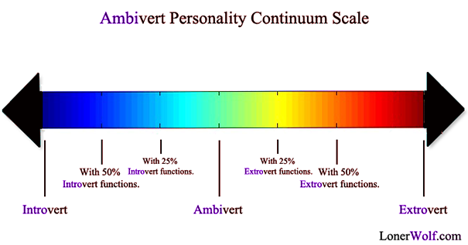
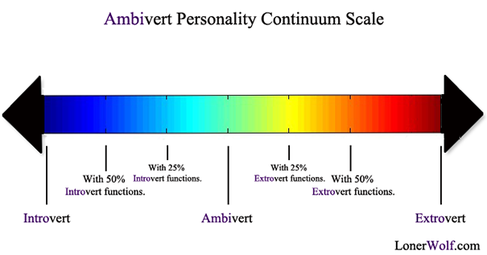

Slide 10

Activity 3
Finding your Path

Slide 11
Purpose
To know your future goal
Start thinking about career and yourself

Slide 12

Survey

Slide 13
Thank You

